Slide 1
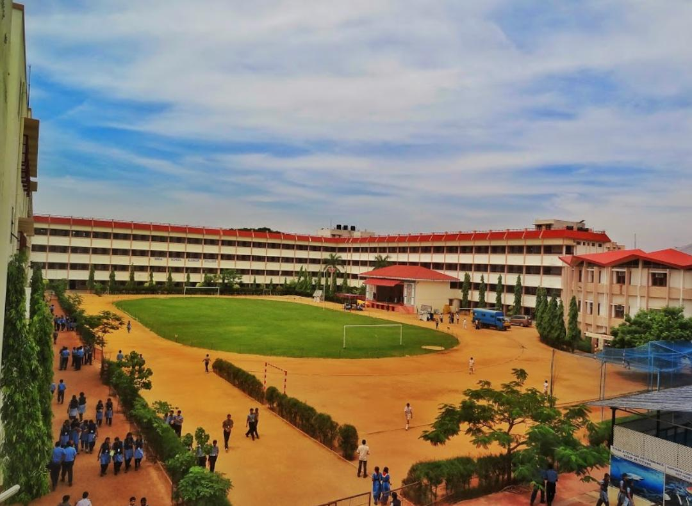
S.B.O.A SCHOOL AND JUNIOR COLLEGE
Tessellation kollam Competition

Slide 2
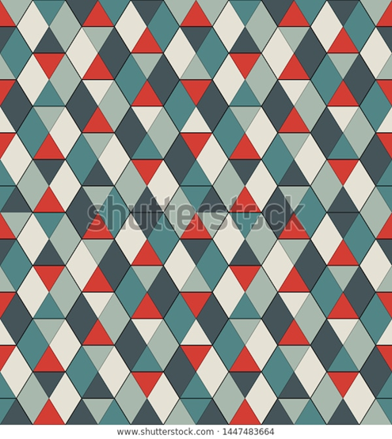
THE HISTORY OF TESSELLATION
Tessellation were used by the Sumerians (about 4000 BC) in building wall decorations formed by patterns of clay tiles. Decorations mosaic tilings made of small squared blocks called tesserae were widely employed in classical antiquity, sometimes displaying geometric patterns

Slide 3
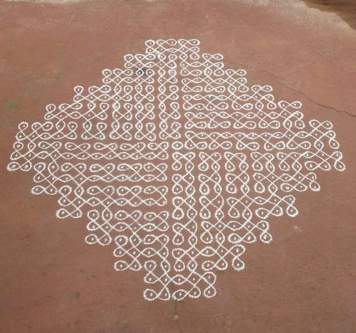
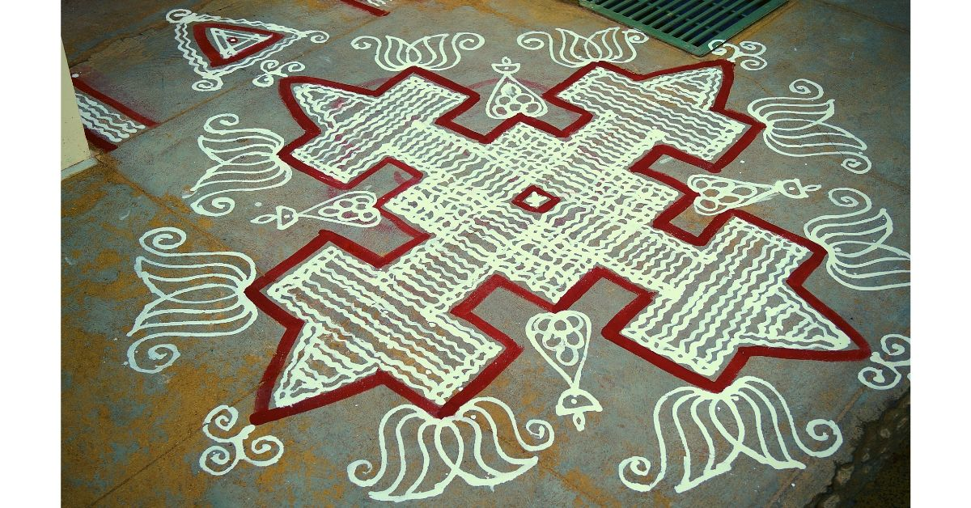
KOLLAM
A Kollam is a geometrical line drawing composed of curved loops, drawn around a grid pattern of dots.

Slide 4
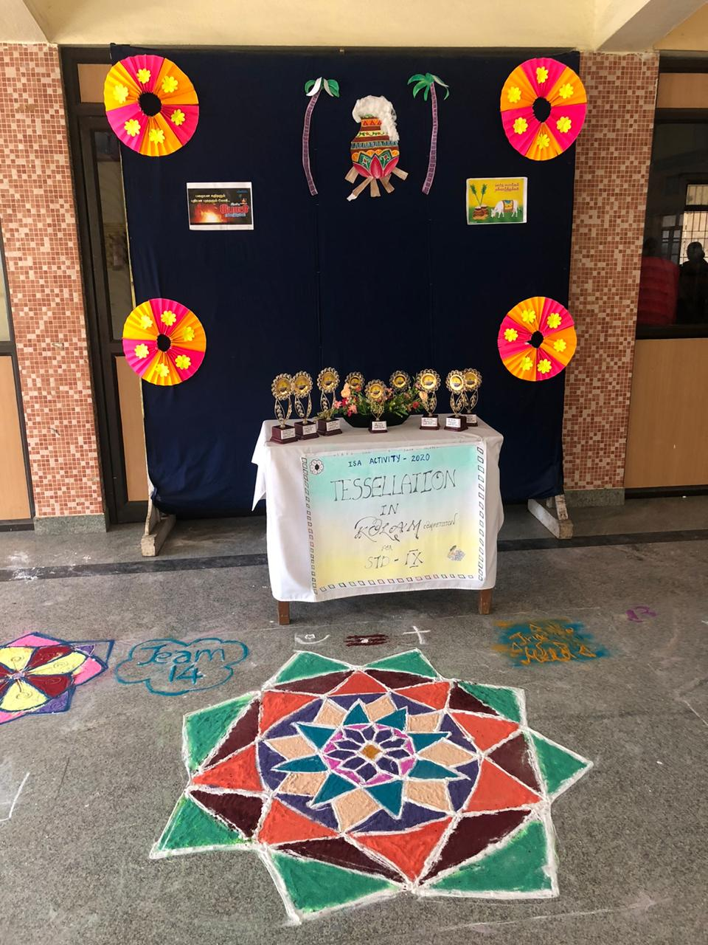
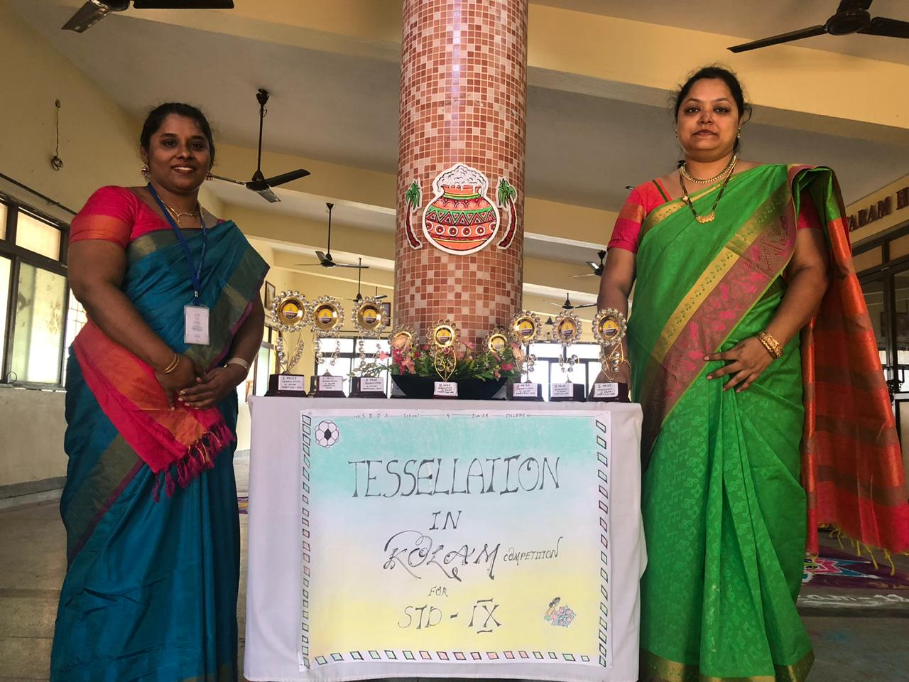
This competition was conducted during the pongal festival. Which has been the most important and joyful festival in South India.

Slide 5
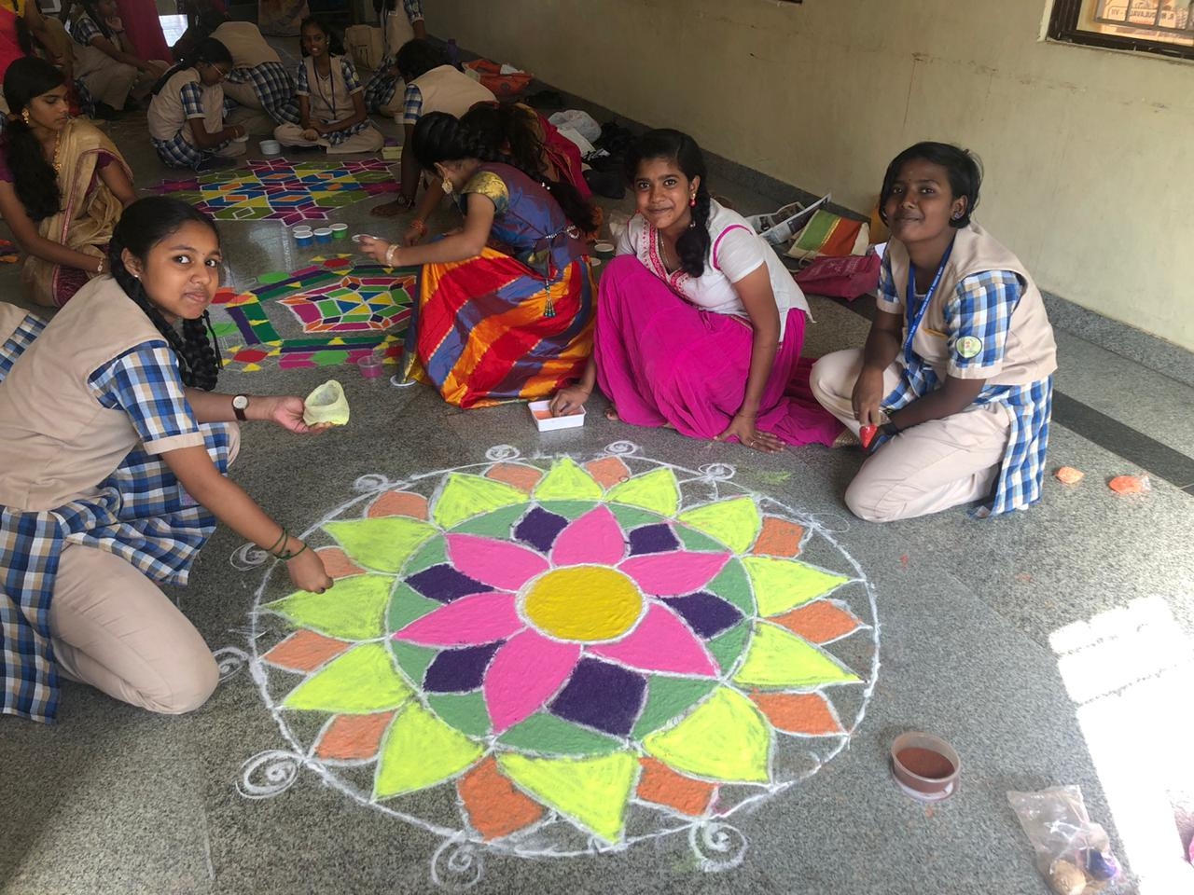
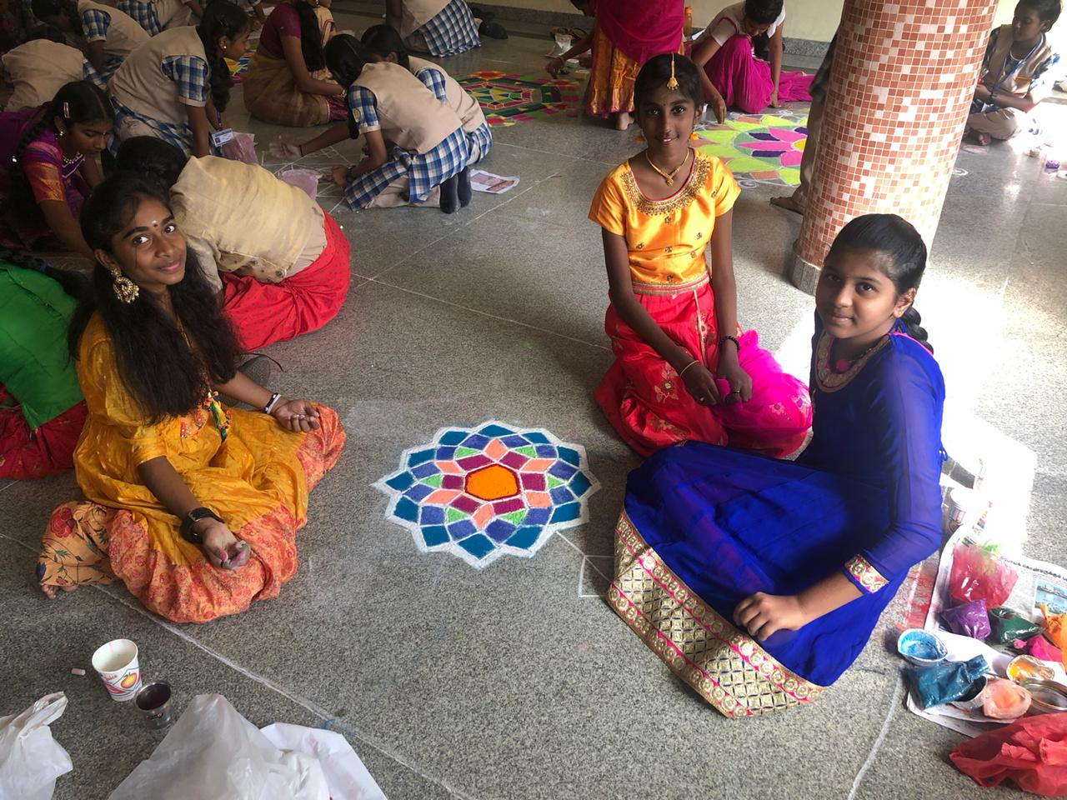
Math's makes our life orderly and prevents chaos. Certain qualities nurtured by math's are power of reasoning , creativity, abstracts or spatial thinking and problem ability and imagination.

Slide 6
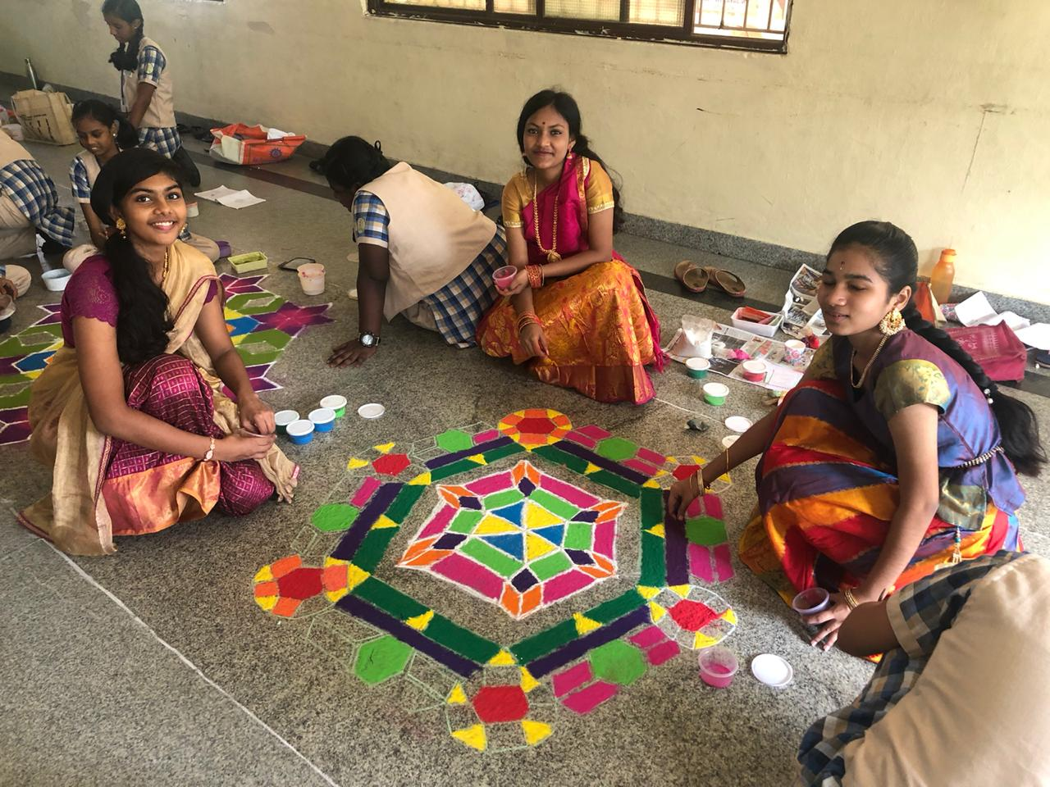
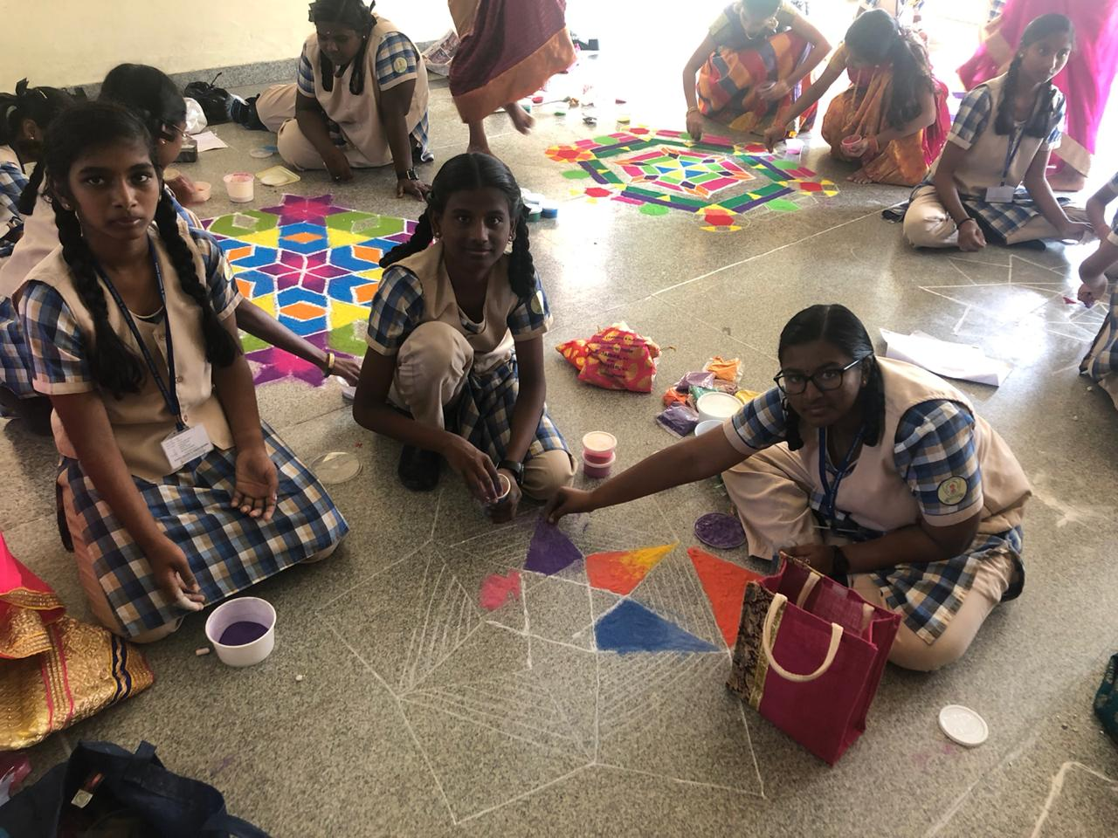
All the Participants gave their imagination and creativity in this competition which should be truly appreciated and admired

Slide 7
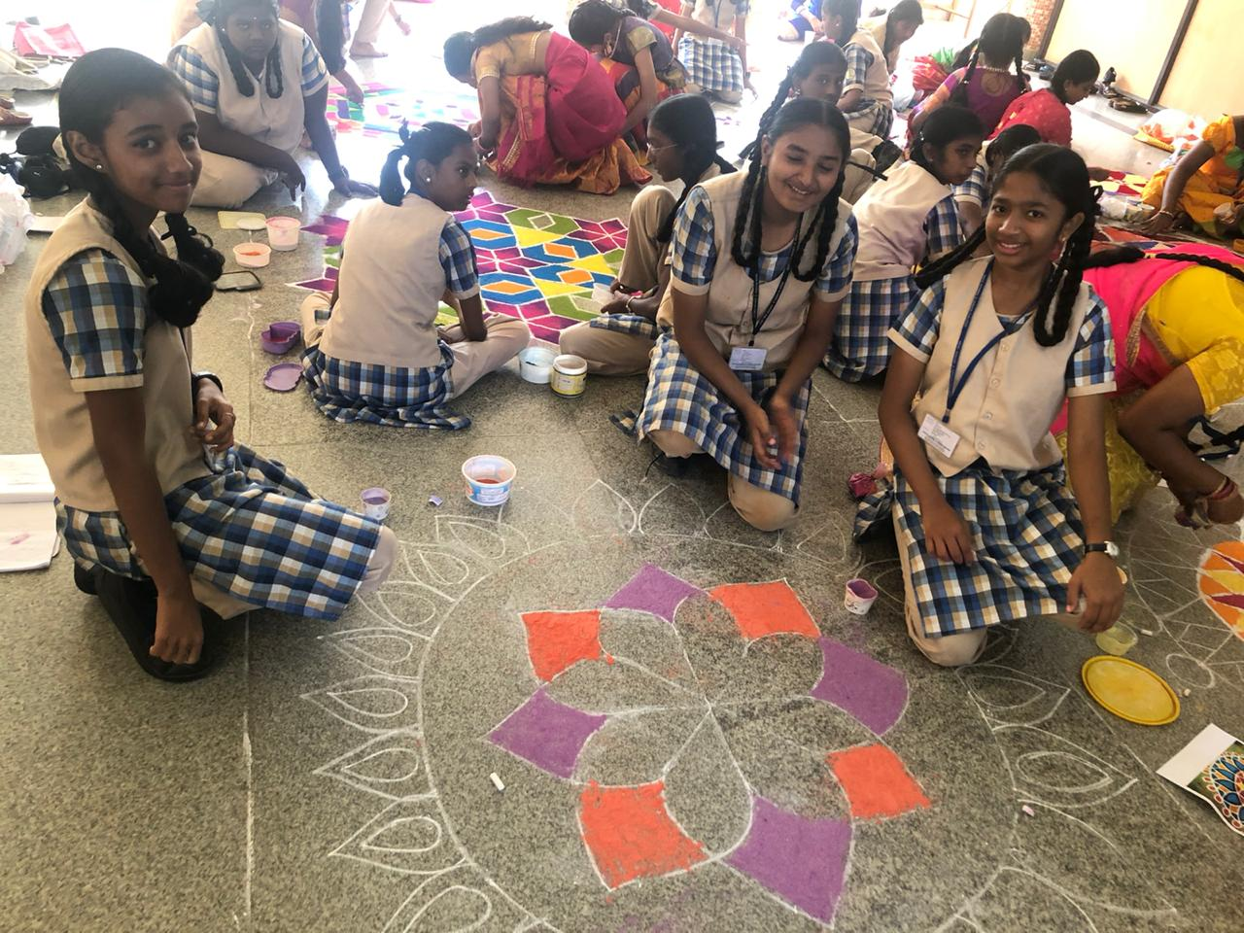
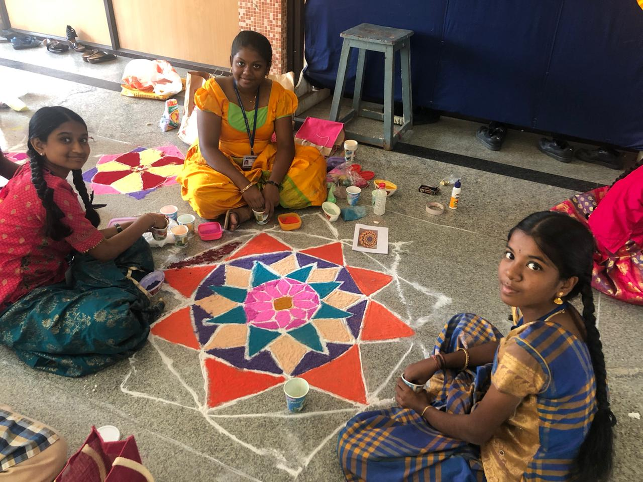
In this busy technological world, we aren’t that much aware of our traditional kollams and about the importance of math so called tessellation been hidden in.

Slide 8
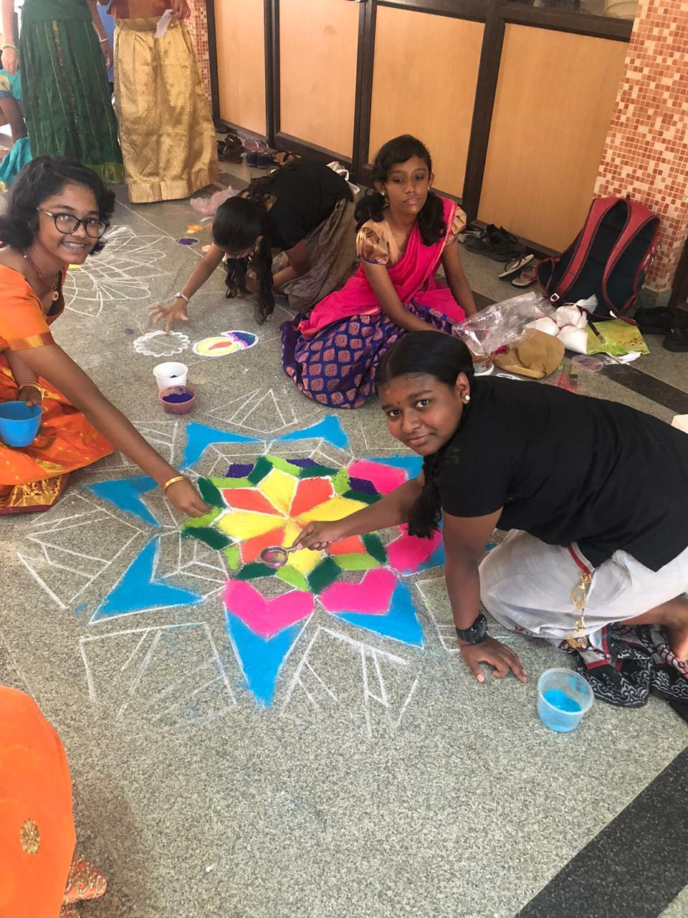
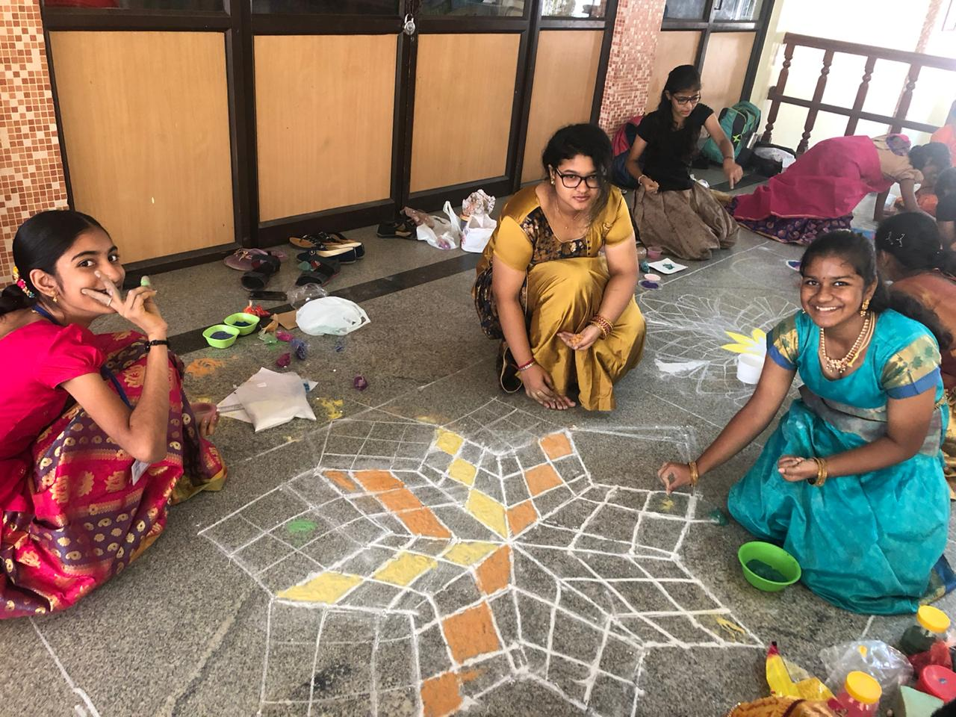
Math isn’t only about working out sums and equations, it also deals with our day to day life.

Slide 9
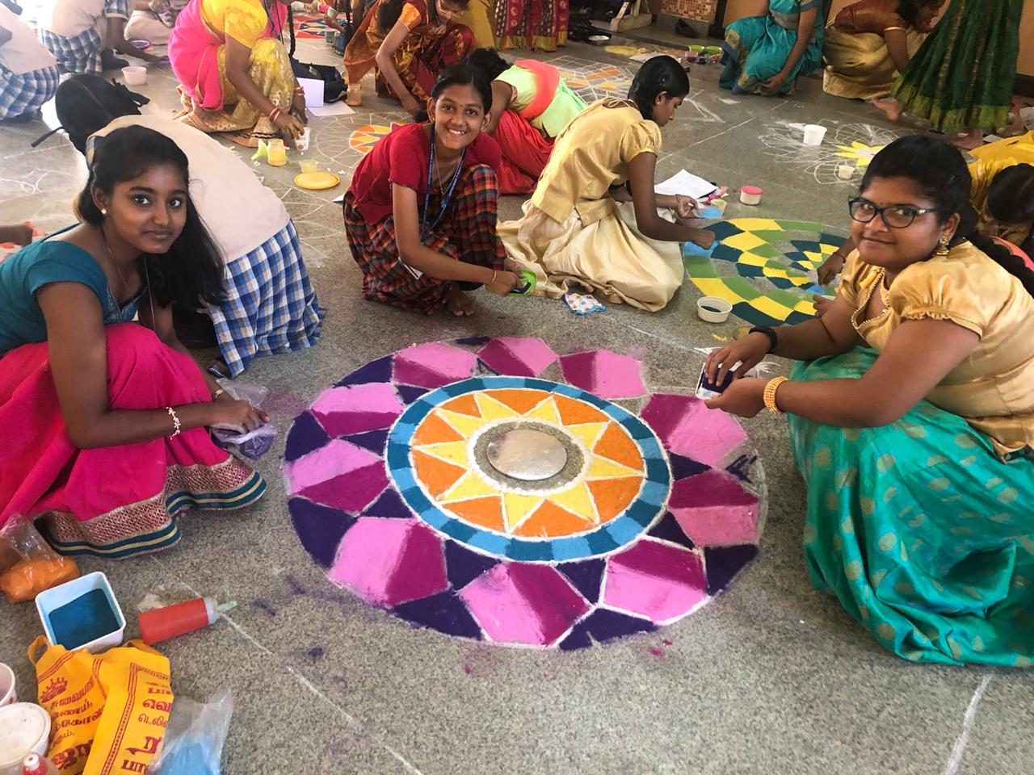
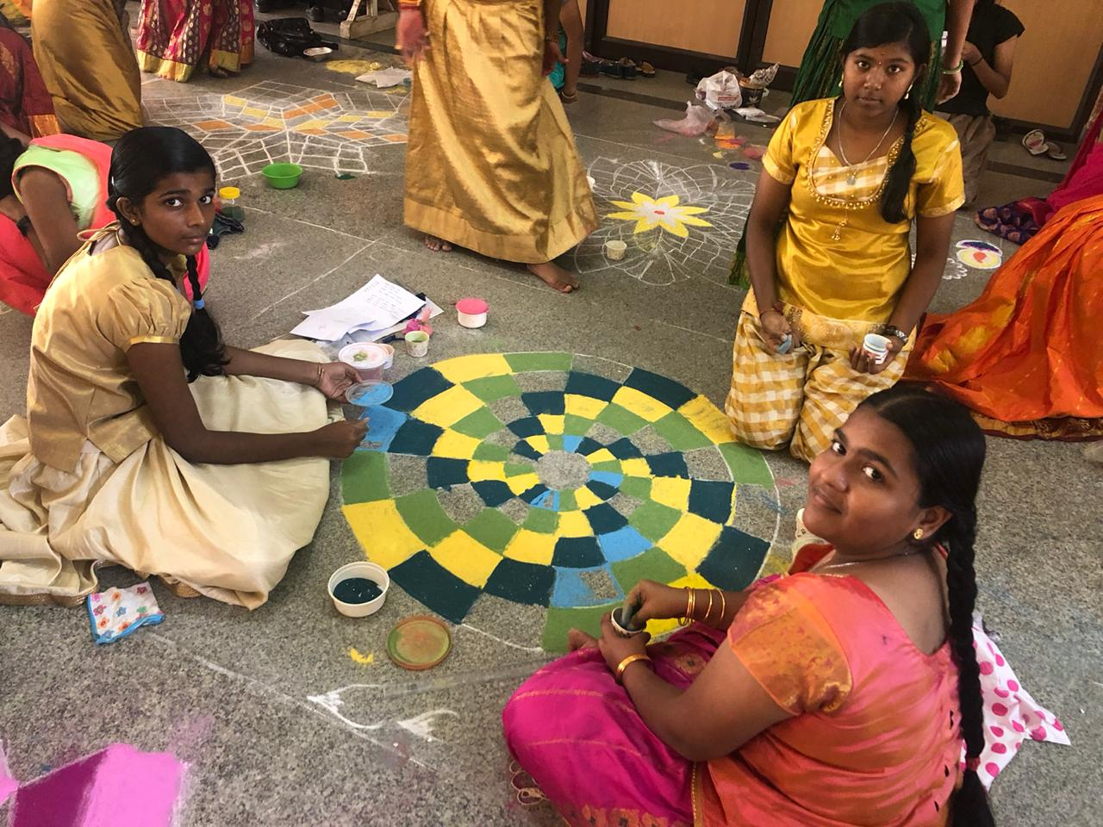
The teachers never failed to encourage the work done by the students, which made them do their work even more enthusiastically.

Slide 10
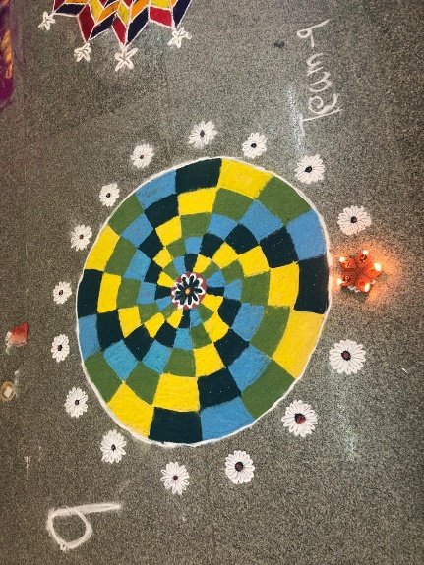
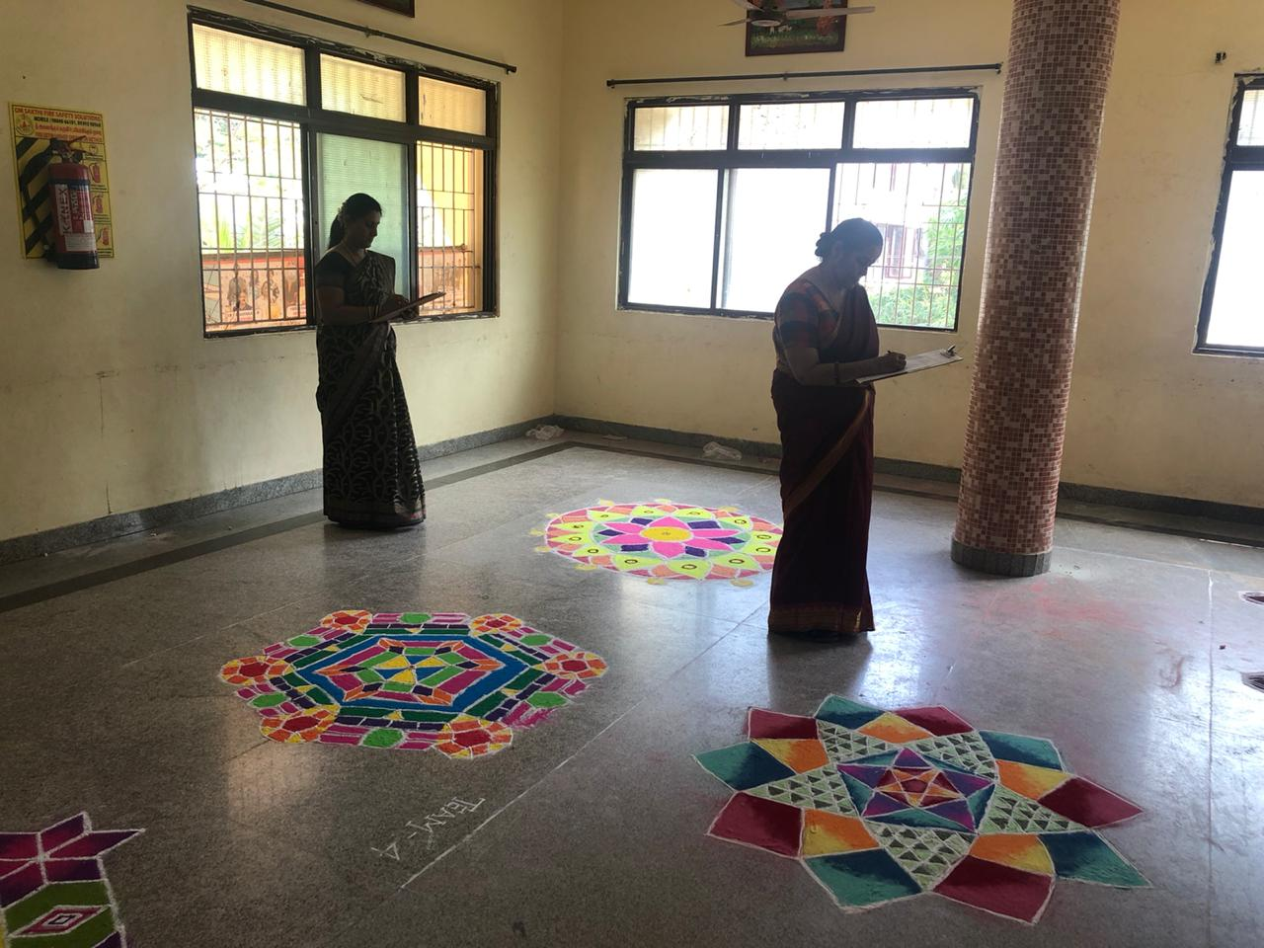
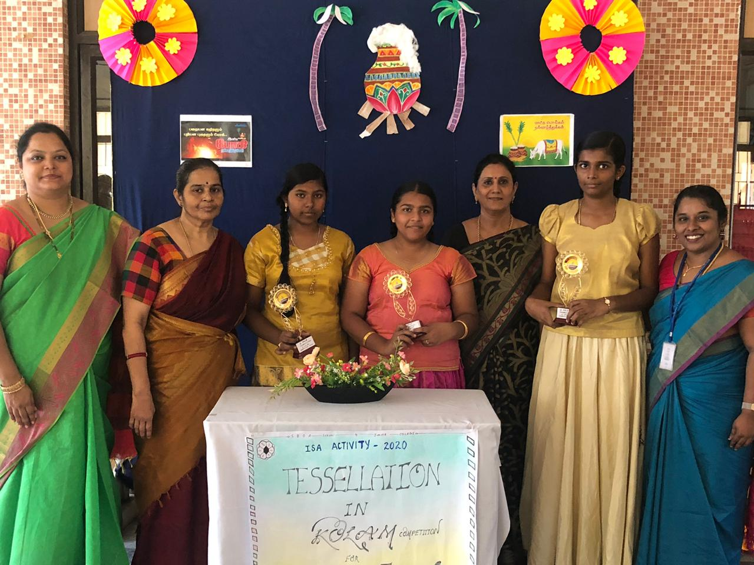
Many kollams were tremendously good, but this was selected by the judges as the best work out of all the kollams.

Slide 11
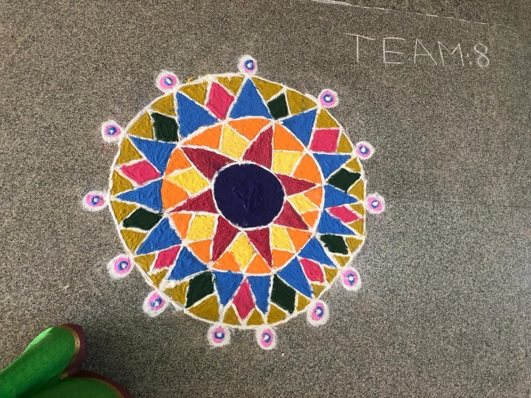
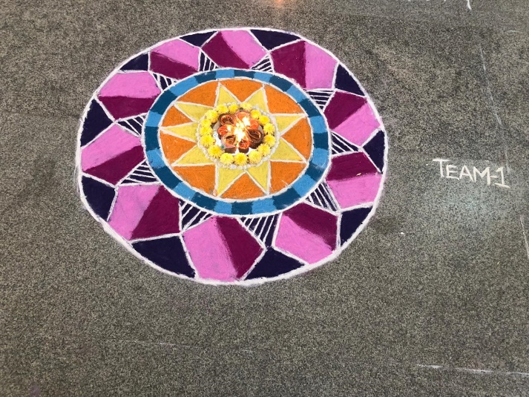
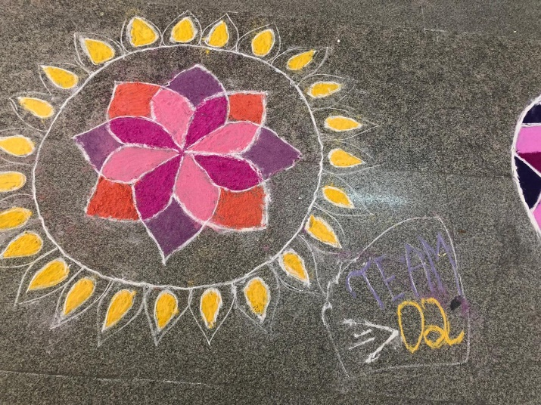
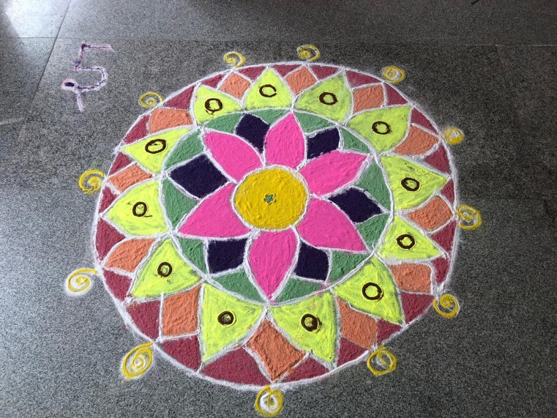
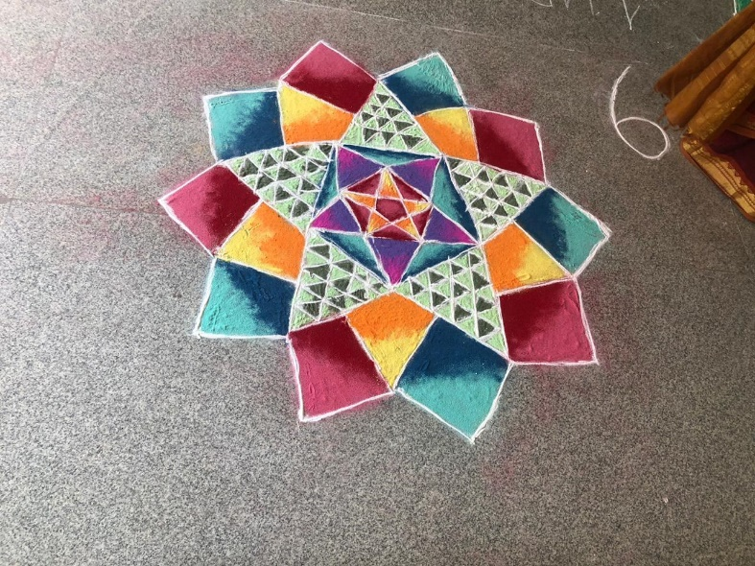
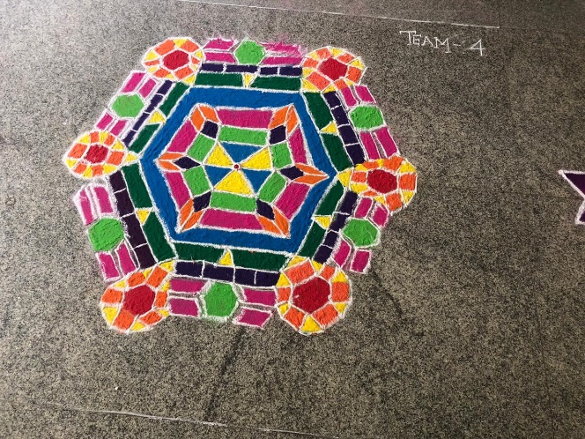
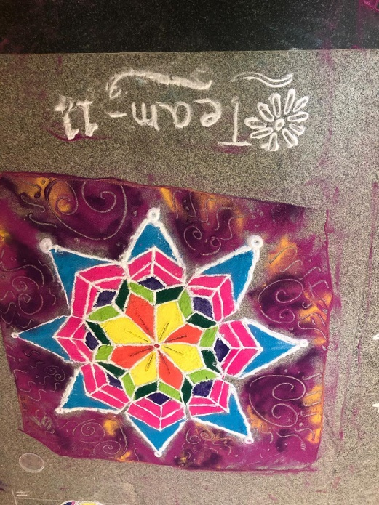
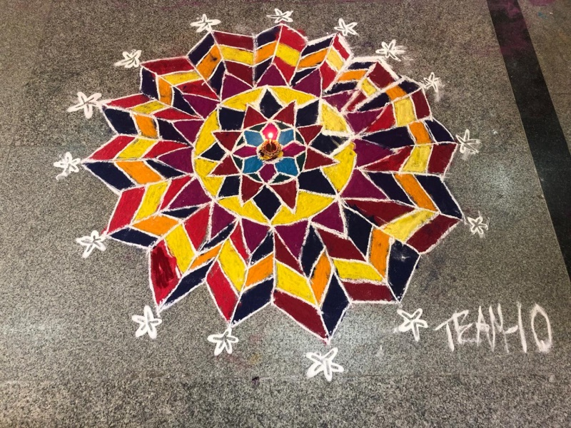
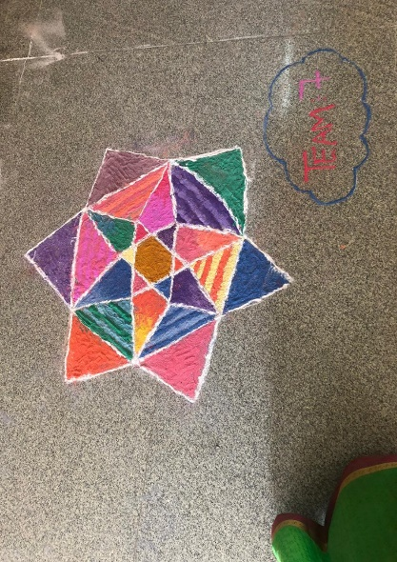
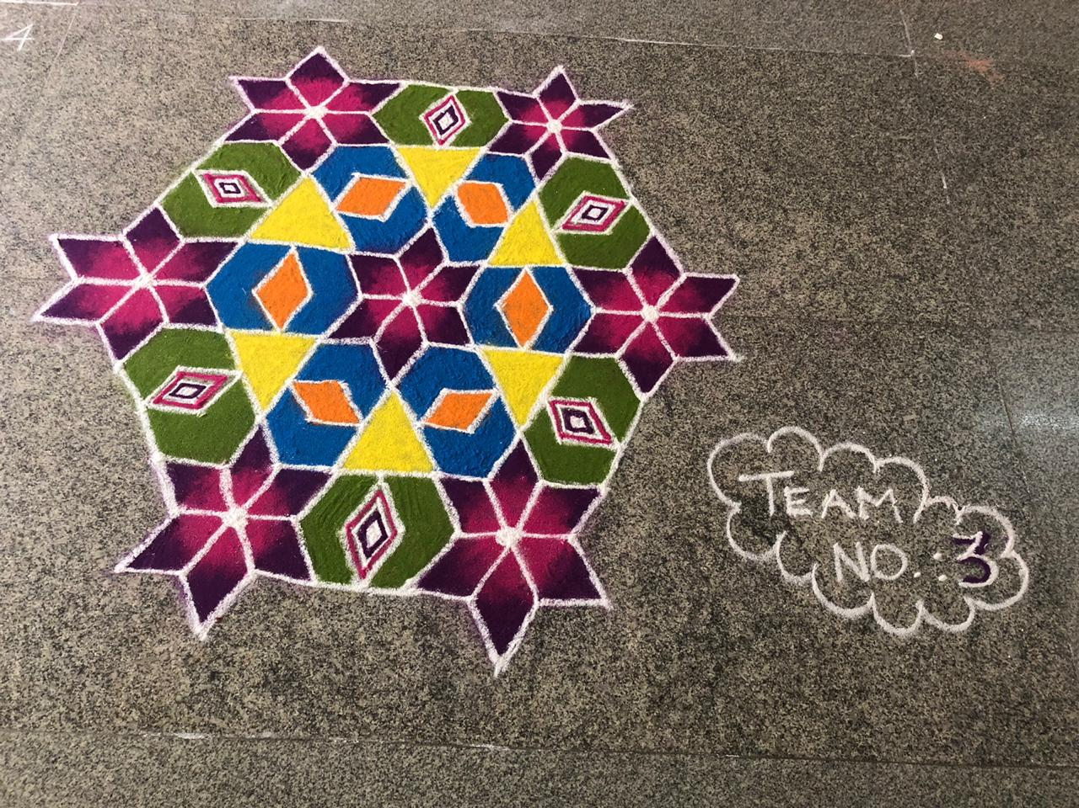

Slide 12
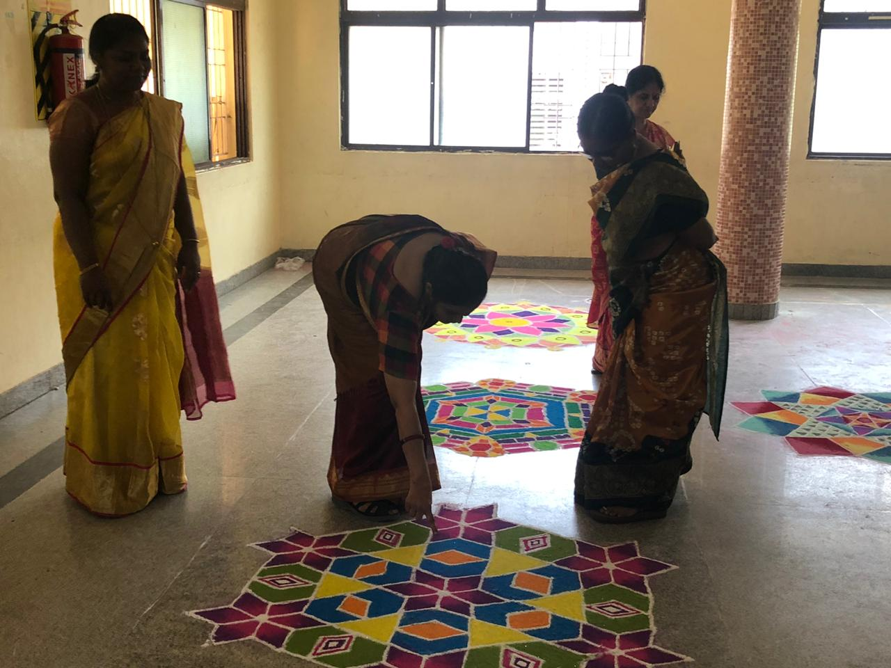
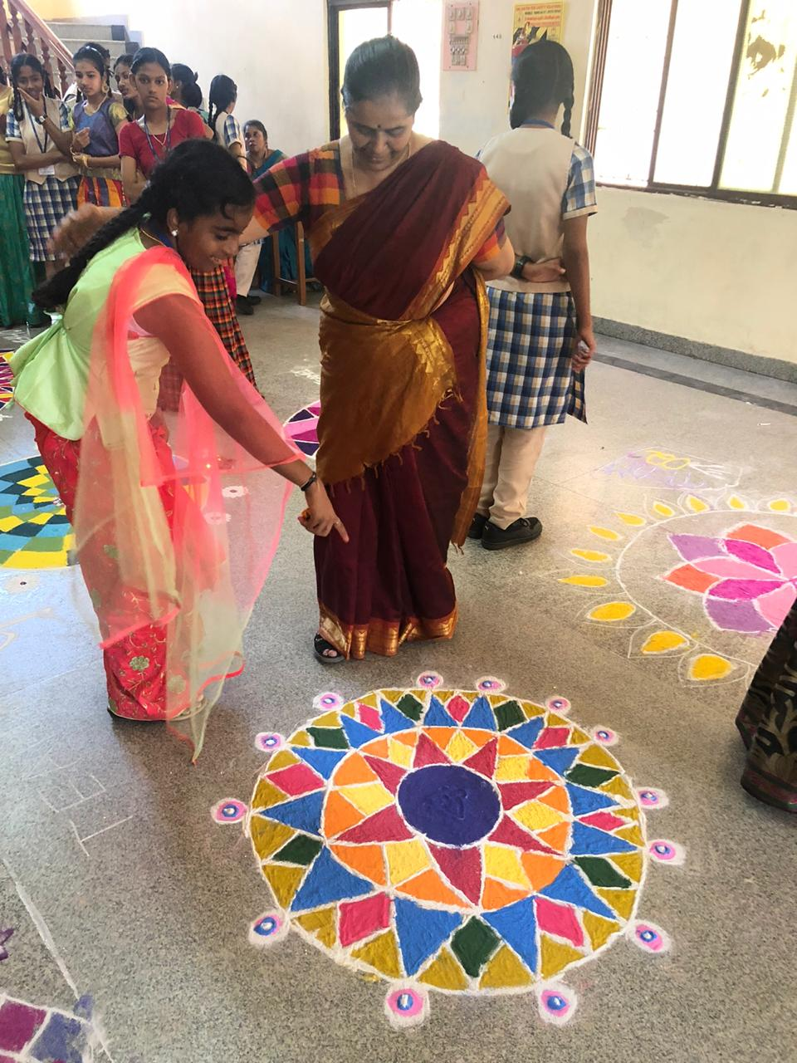
Knowing is not enough, we must apply, wishing is not enough, we must do. Each and every part of the Kollam were observed and evaluated by the judges and complimented the students efforts.

Slide 13
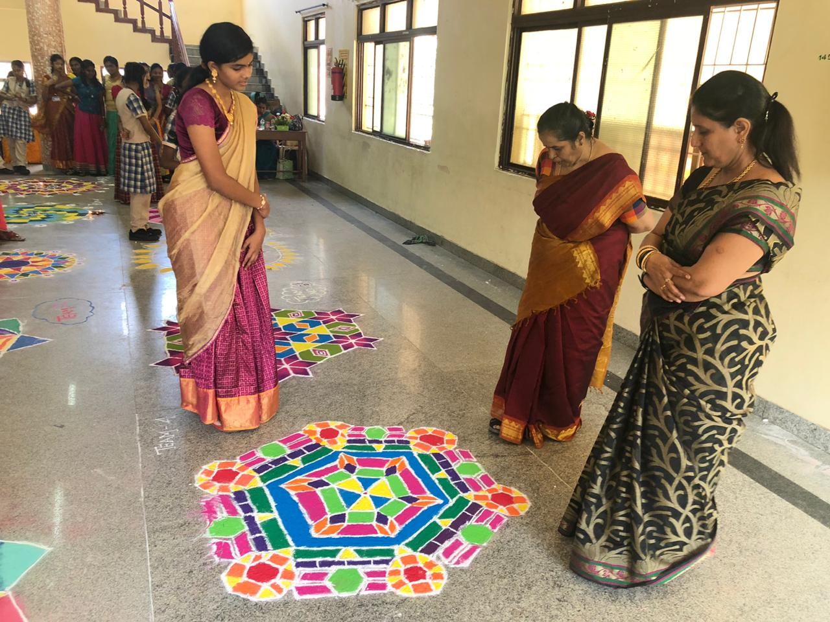
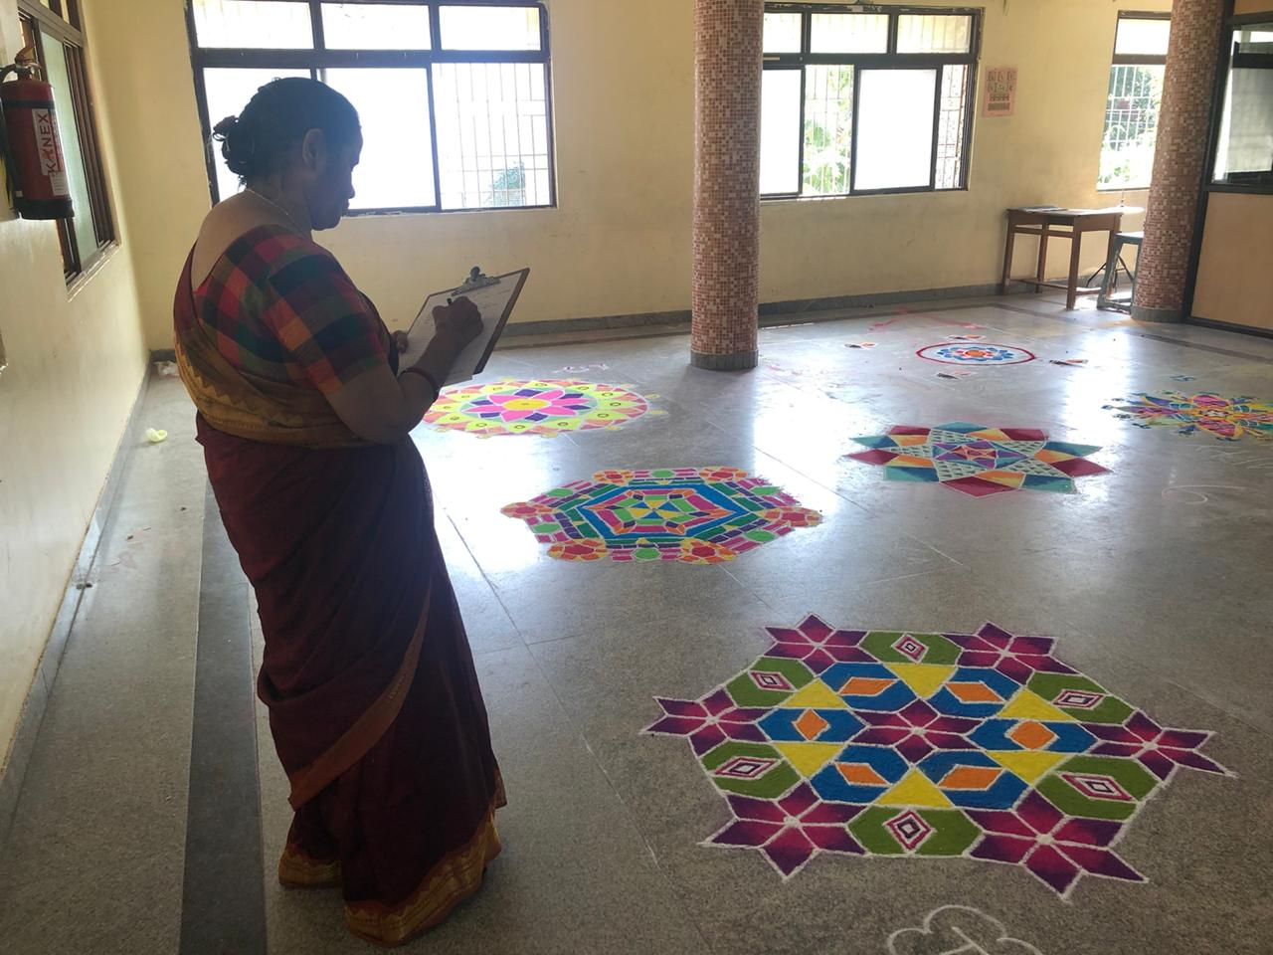
Kollams are thought to bring prosperity to home. We have been implementing this artwork since ages before, but we realized this lately and now we get to know more about it.

Slide 14
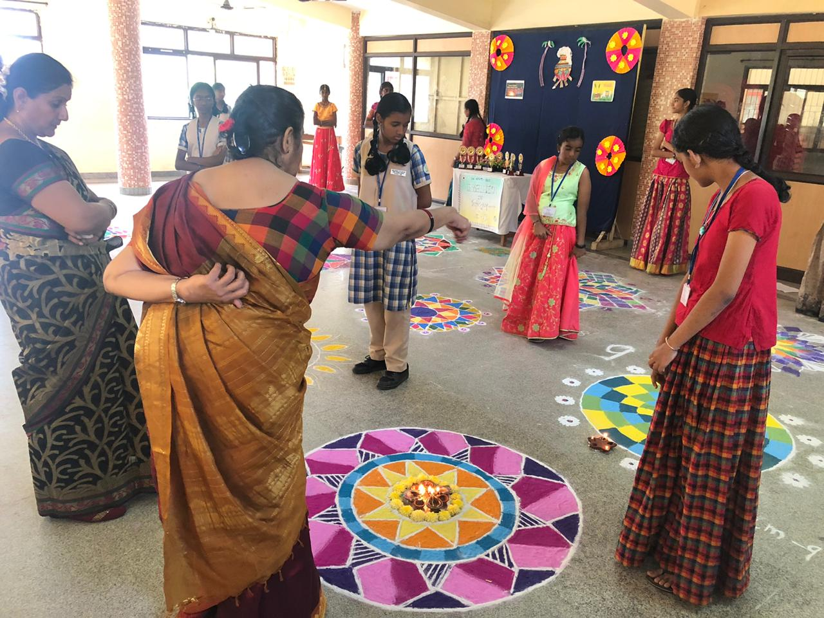
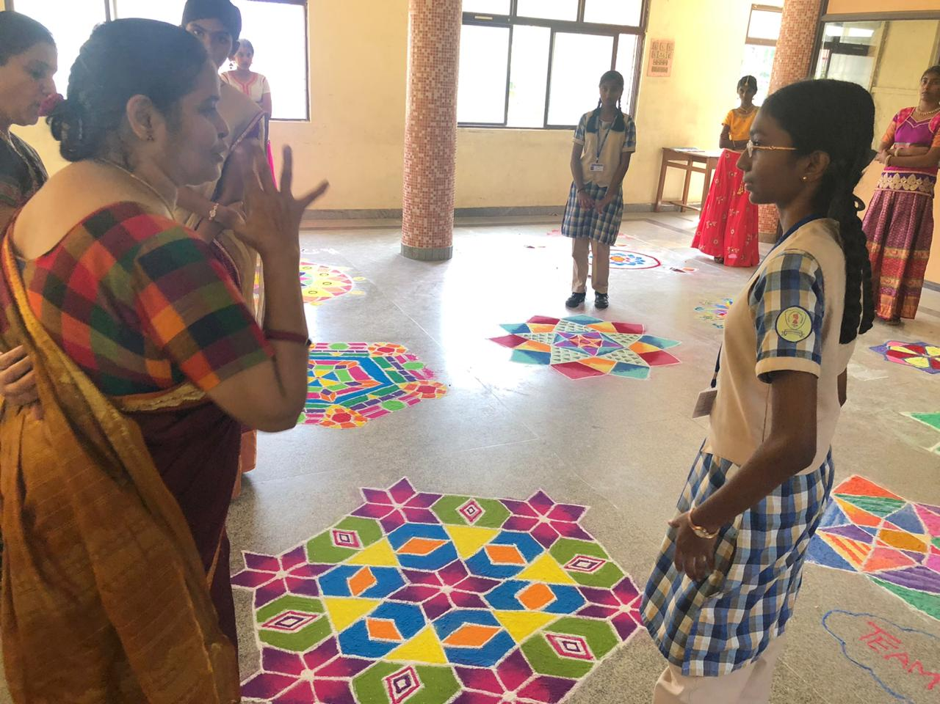
Before announcing the final results, the judges came around and said many informative and wonderful facts about tessellation that we students should know.

Slide 15
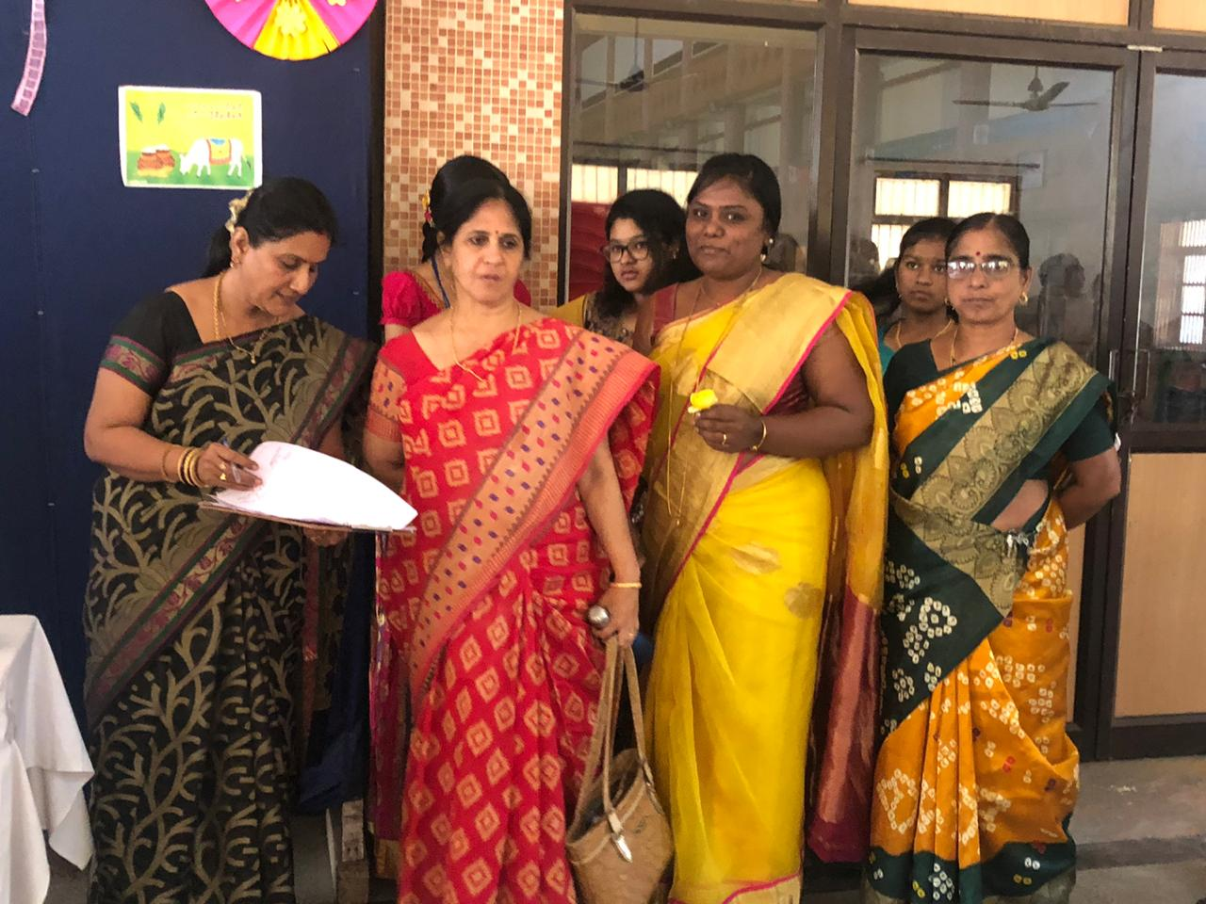
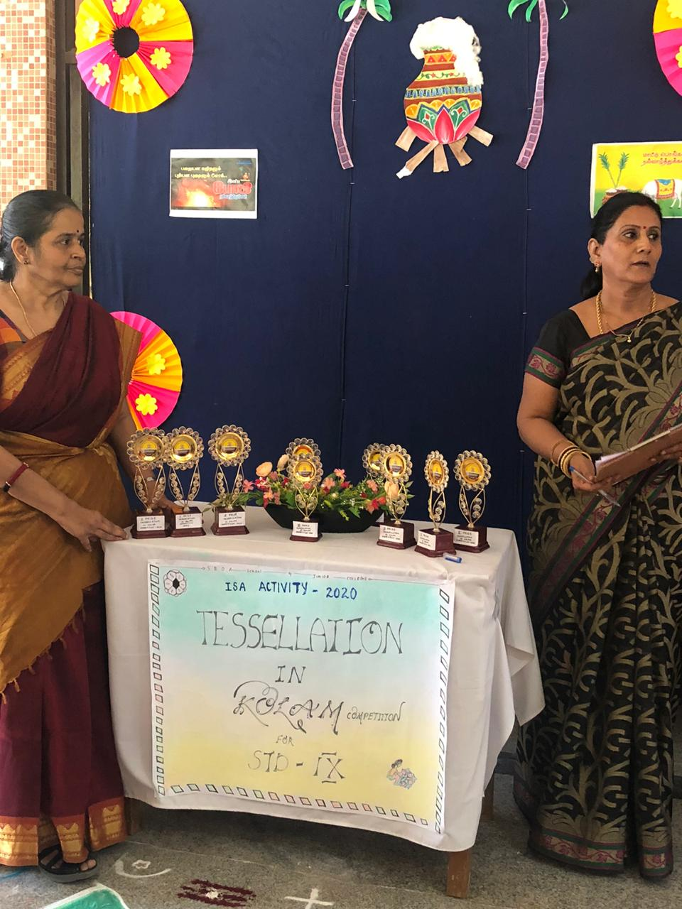
The judges were well experienced math teachers, who knew more about the concepts in math and so they taught us many concepts.

Slide 16
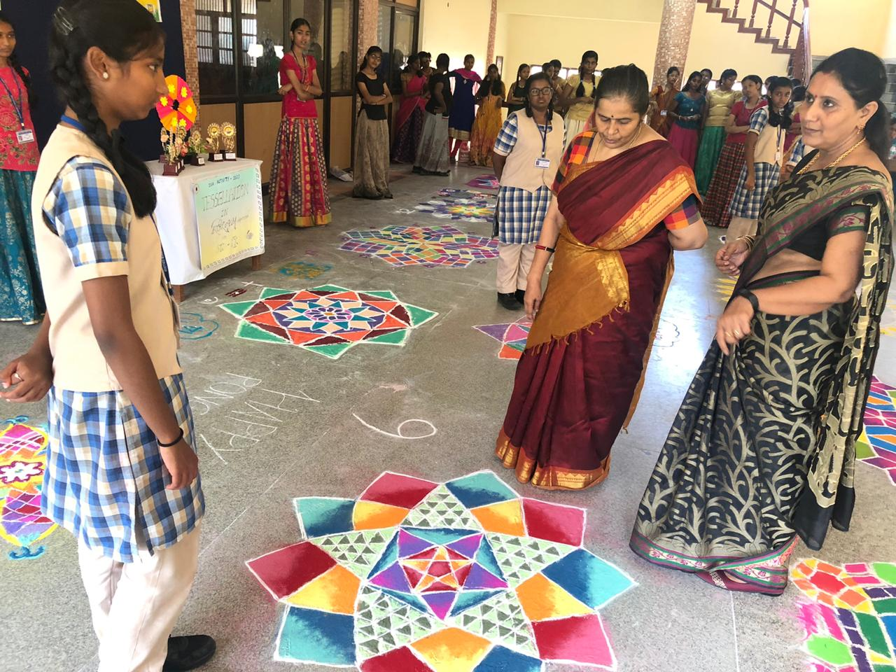
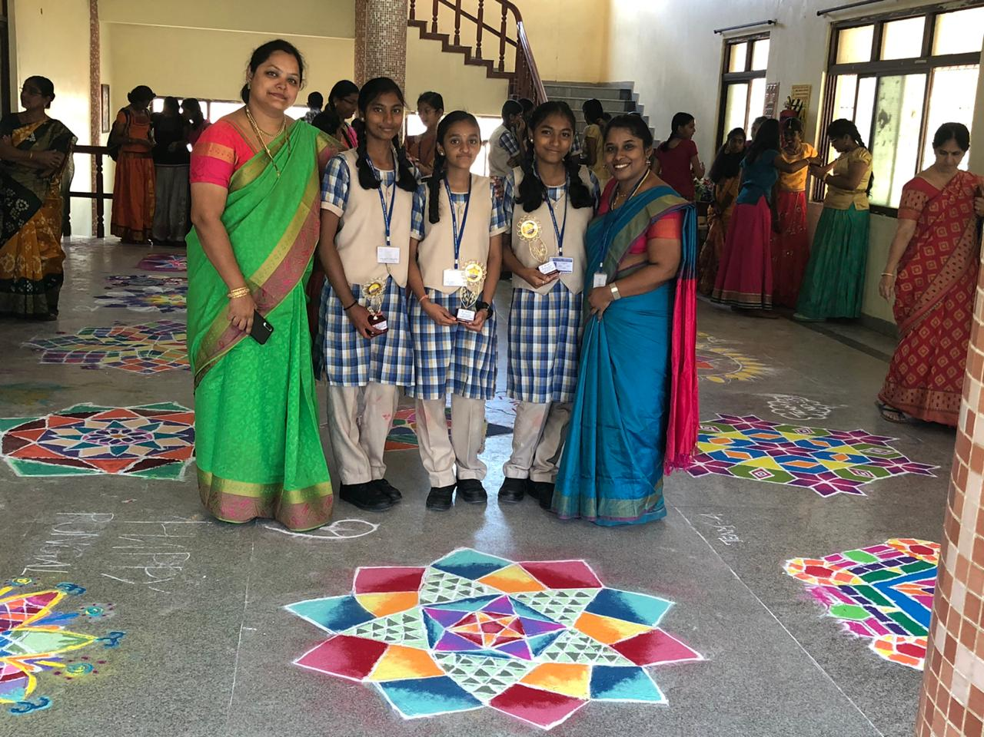
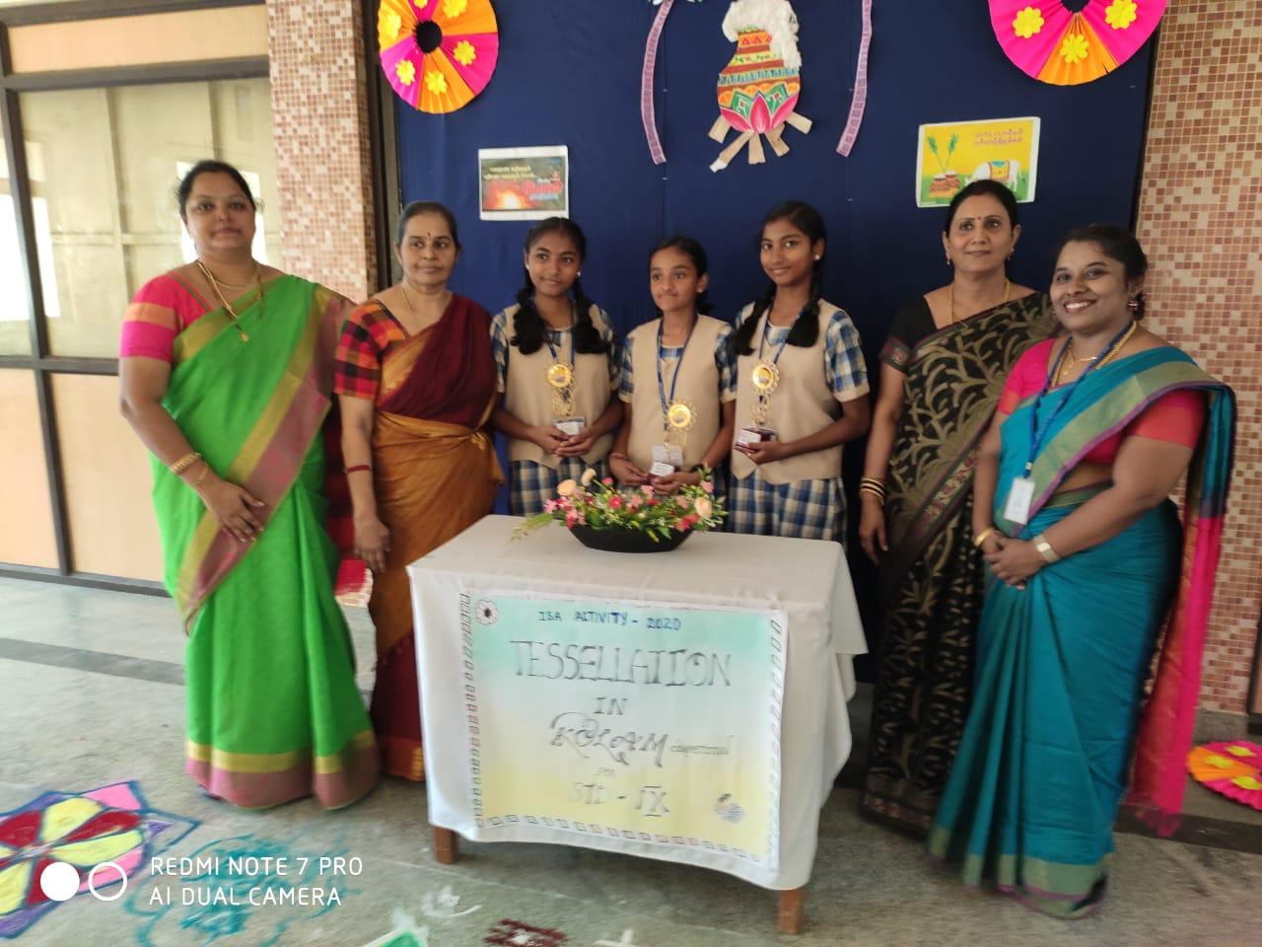
The Kollam which was done by the 6th team was given the second prize, as it exhibited the concepts of tessellations.

Slide 17
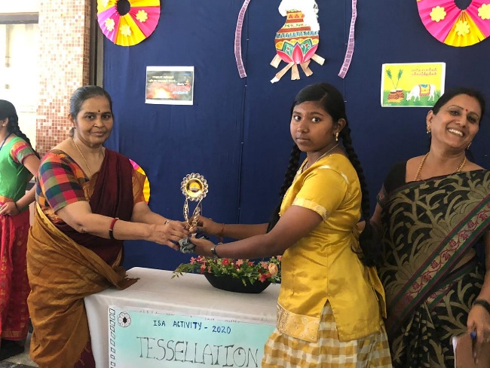
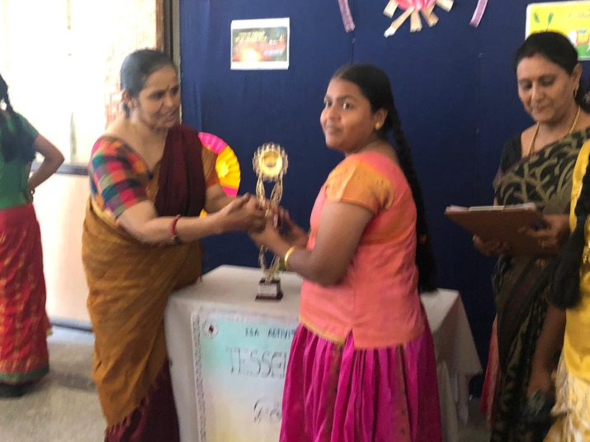
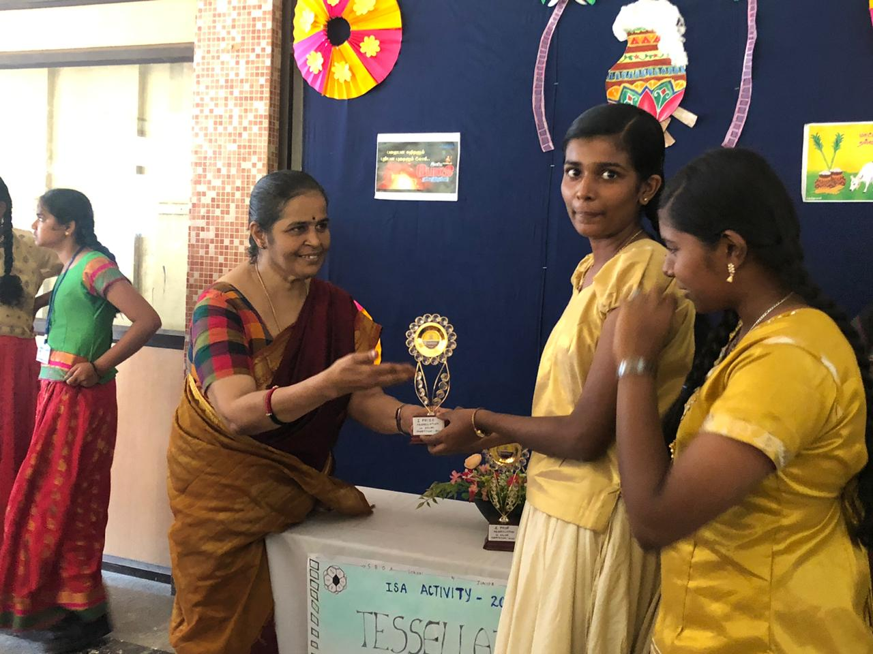
B. Kotteeswari
J. Sri Danya
L. Lakshimi Priya

Slide 18
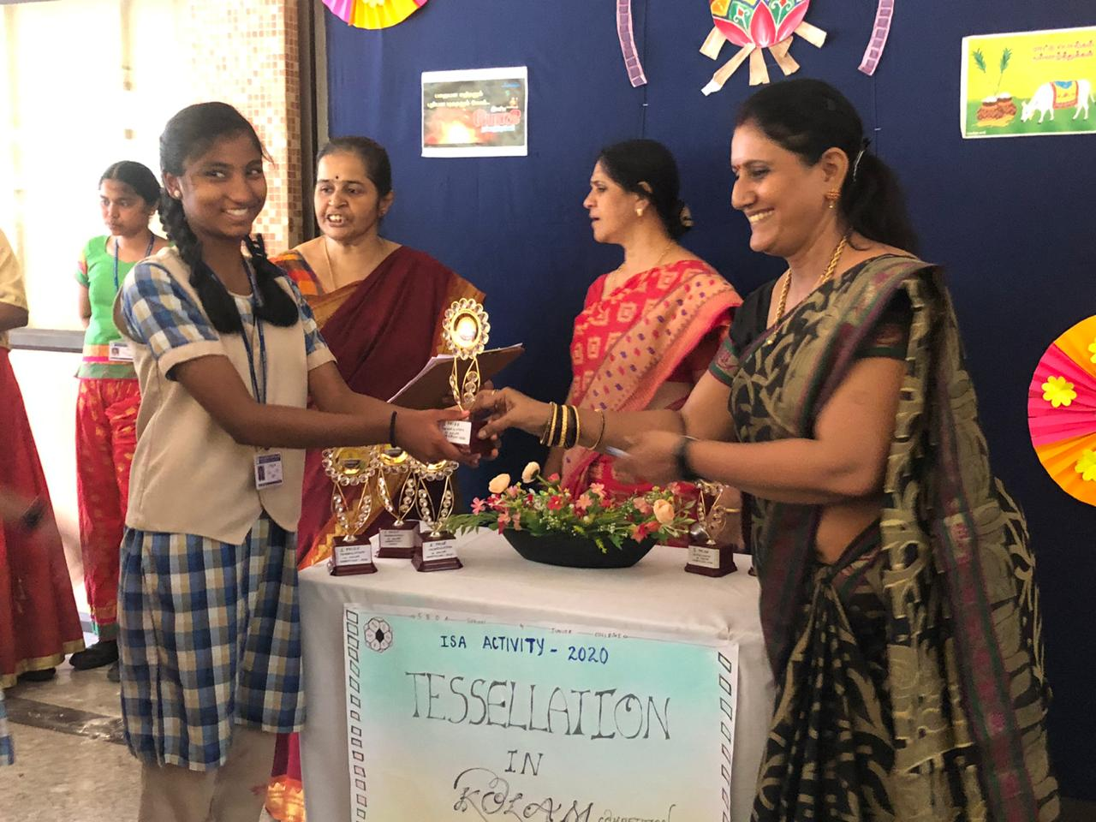
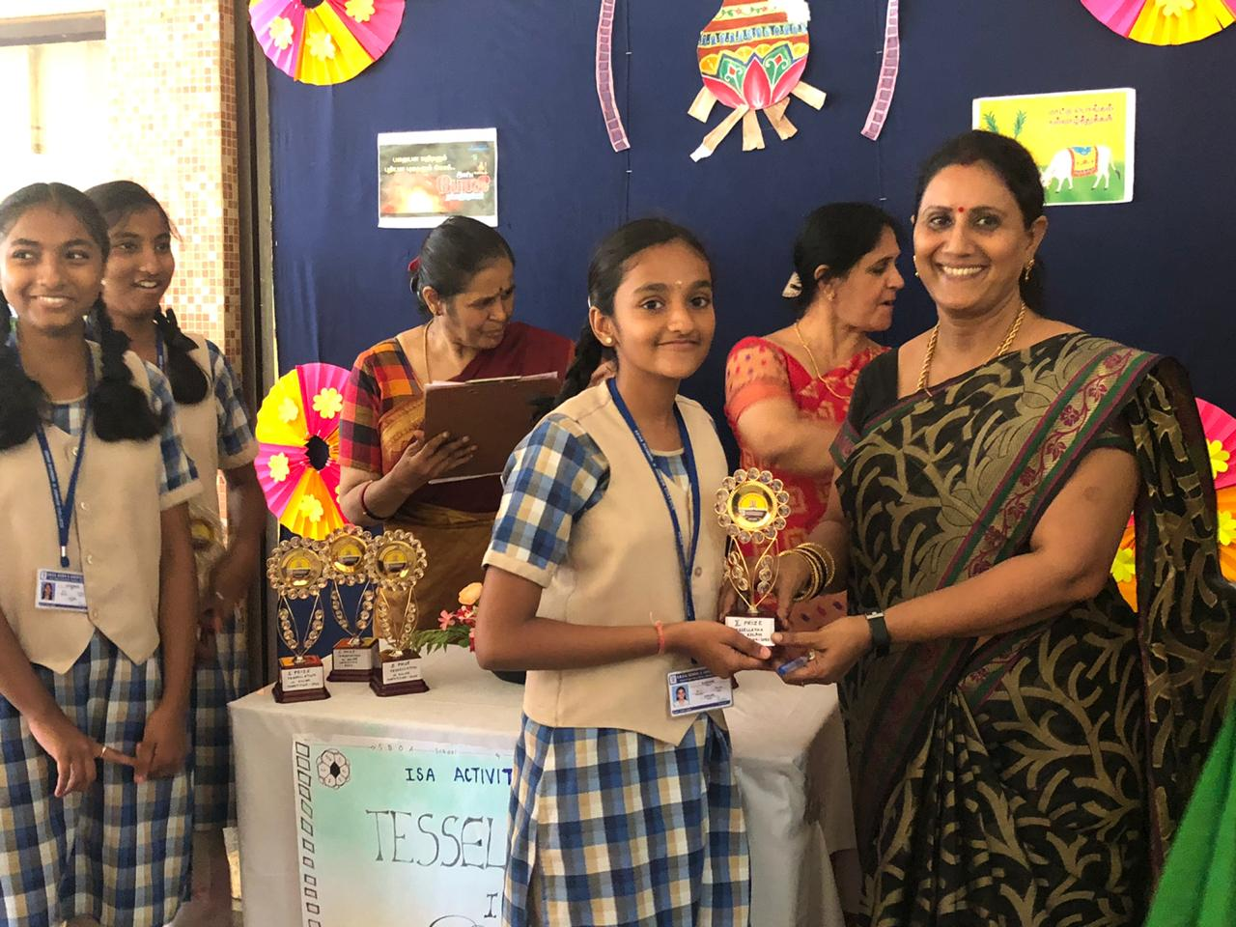
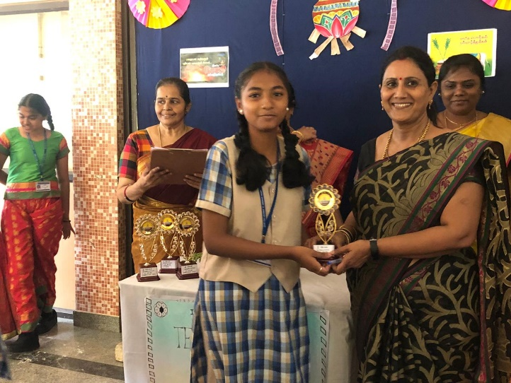
G. Tanya Sri
S. Hoshini
G. Tharanya

Slide 19
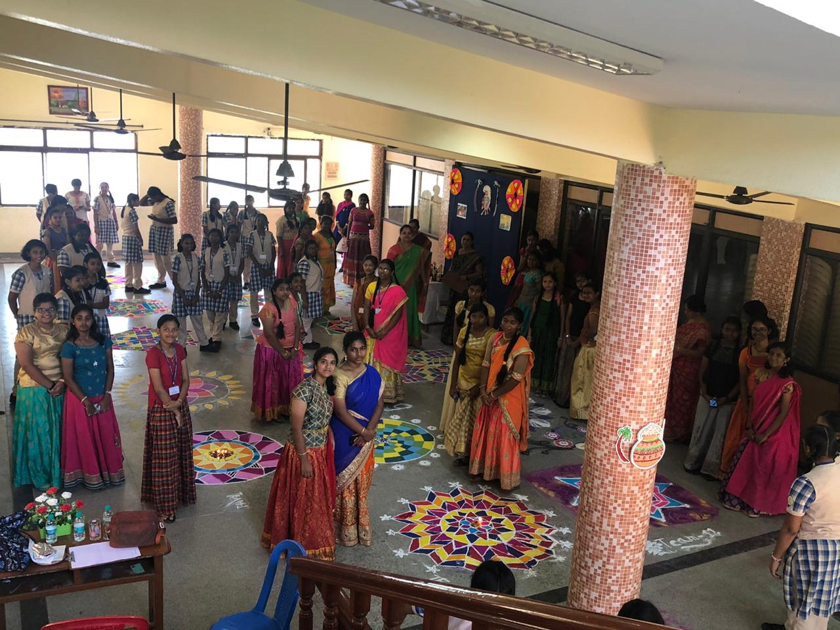
Memories are timeless treasures of the heart. That day was filled with so much laughter and colorful memories. This gave us a good experience in knowing about our tradition and tessellation.

Slide 20
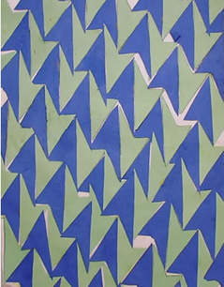
THANK YOU

